Slide 1
CIS 565 FINAL PROJECT CUDA Feature Matching and Object Tracking Final Presentation by Yash Vardhan

Slide 2
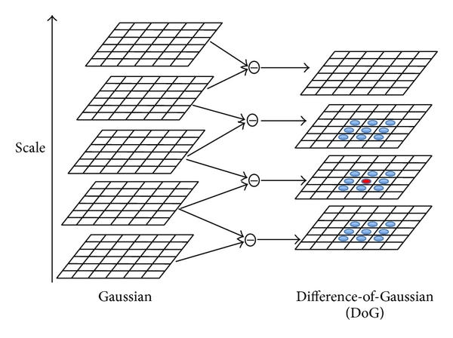
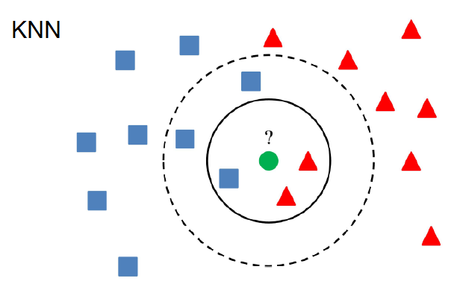
FEATURE MATCHING pipeline
Feature Detection
Feature Description
Feature Matching
Use XOR to compare
BRIEF Descriptors
Notes:
Encodes pixel area around detected feature to a binary string.
Knn to find 2nd nearest neighbor (best match)

Slide 3
CUDA OPTIMIZATIONS
Dynamic Programming
Shared Memory
Loop Unrolling by factor of 2
Remove Bank Conflicts
Thread workload balancing
Notes:
Dynamic Programming - Store results to avoid re-computation
Shared Memory – filters used by threads repeatedly
Fetching of data into shared memory was distributed among all threads equally instead of just one.

Slide 5
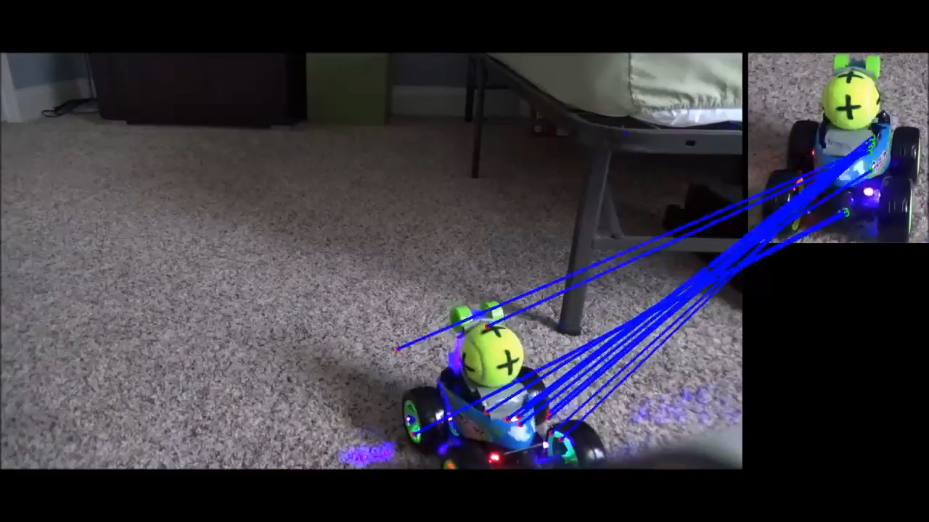
RESULTS

Slide 6
OBJECT TRACKING pipeline
Draw Box on object
Track Motion using KCF
Update Box till
end frame

Slide 7
KCF Tracking
Object Detection in box
Descriptor Matrices Calculation
Reduce dimensions of descriptors using PCA
Perform Kernel Regression on updated features
This gives new position for bounding box
NOTE – Each step involves decompressing and compressing descriptors.
Notes:
Detection – compute Gaussian kernel and calculate fft
Descriptor Matrices Calculation – serves as Input Features for Machine Learning

Slide 8
CUDA OPTIMIZATIONS
Used CUDA Fast Fourier Transform Library
Shared Memory
Avoiding Bank conflicts
Using Streams
Used openCV’s GpuMat instead of Mat for kernel calls
Notes:
Computing Gaussian Filters through changing openCV’s FFT calls to cuFFT calls such that spatial to frequency domain transform included DOUBLE instead of FLOAT to be later used in frequency to spatial transform – 18 ms saved locally (2.3x speedup)
Calculating Covariance Matrix to update input features(PCA) a.k.a. matrix multiplication of X (input pixels) and X-transpose – 11 ms saved

Slide 10
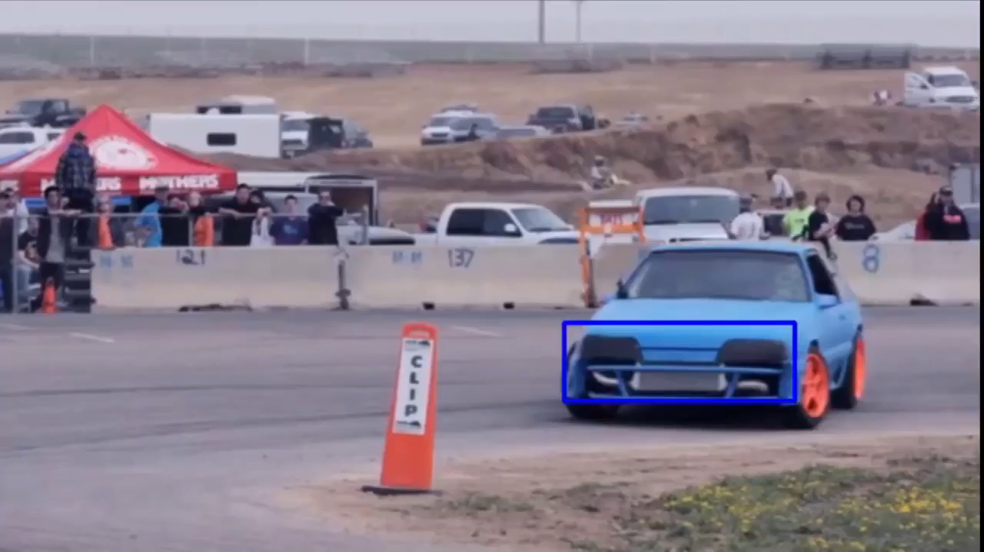
RESULT

